Slide 1
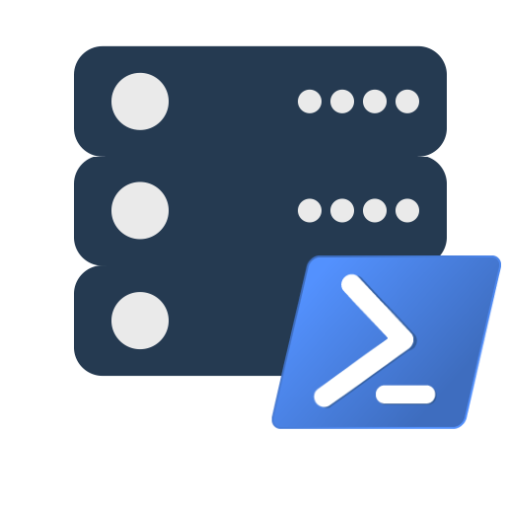
intro to dbatools
Chrissy LeMaire, MVP & Rob Sewell, MVP

Slide 2







Thank you to our AWESOME sponsors!

Slide 3
About
Chrissy LeMaire - @cl
PowerShell MVP
Creator of dbatools.io
Belgian PowerShell UG, PSConf.eu organizer
DBA with General Dynamics IT at NATO Spec Ops HQ
Rob Sewell - @sqldbawithbeard
PowerShell MVP
Creator of SQLDiagAPI
PASS PowerShell VG, SQL Saturday Exeter
PowerShell Consultant and Trainer

Slide 4

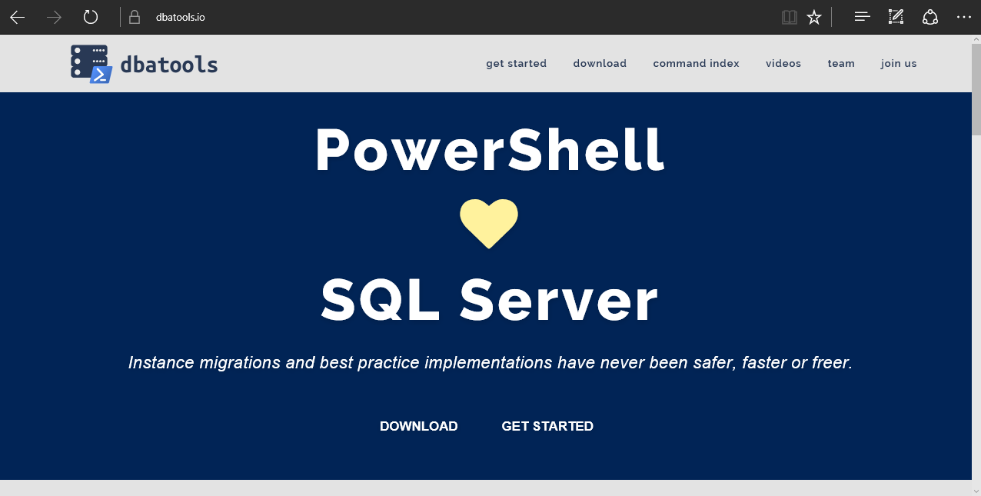
dbatools

Slide 5
Support
SQL Server 2000 – vNext
Express – Enterprise Edition
Clustered and stand-alone instances
Windows and SQL authentication
Default and named instances
Multiple instances on one server

Slide 6
System Requirements
Minimum
Client
PowerShell v3
Server
SQL Server 2000
No PowerShell for pure SQL commands
PowerShell v2 for Windows commands
PowerShell remoting enabled for Windows commands
Recommended
Client
PowerShell v5.1
Server
SQL Server 2008R2+
No SMO Required! Thanks Microsoft 😍

Slide 7
Install is easy
PowerShell Gallery
Install-Module dbatools
Install-Module dbatools –Scope CurrentUser
GitHub – dbatools.io/git
Invoke-Expression (Invoke-WebRequest https://dbatools.io/in)
Offline installer
dbatools.io/offline

Slide 8
How to Get-Help
Extensive documentation within each command Get-Help Start-DbaMigration –Detailed
Extensive documentation on dbatools.io
dbatools.io/Start-DbaMigration
dbatools.io/Repair-DbaOrphanUser
Some commands have videos
dbatools.io/youtube

Slide 9
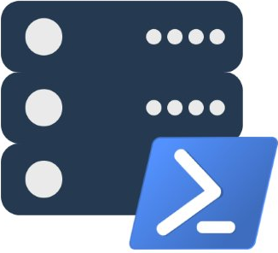
demo

Slide 10
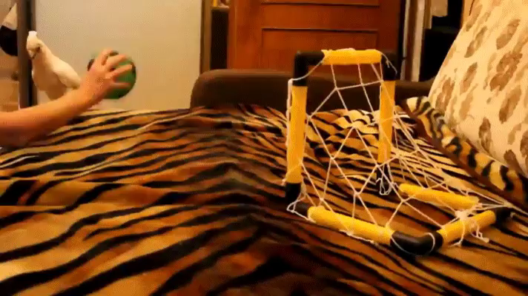
Community got us feelin like

